Slide 1
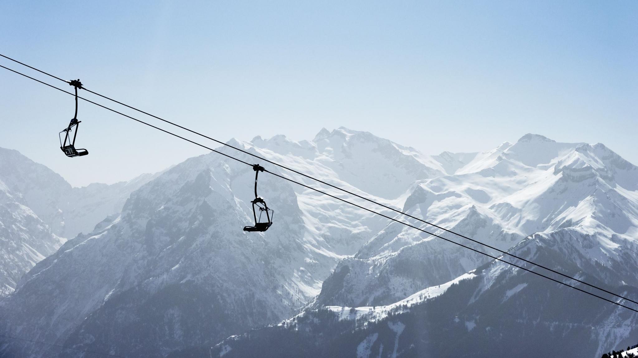
Big Mountain Resort
Nicholas Woytowitz

Slide 2
Problem Statement Worksheet (Hypothesis Formation)
Big Mountain believes that they are not reaching their full potential in terms of revenue generated by ticket sales and want to investigate what their market value is as well as where to invest money to best increase value.
H
1
Context
4
Constraints within solution space
Big Mountain is a ski resort in Montana, and they believe they are selling lift tickets at a discount compared to the respective quality of their features. In addition they recently added a new lift that costs 1.54M in operating costs. They are hiring a data scientist to evaluate data from Big Mountain, and other mountains in the US to determine their market value, as well as key areas to invest.
With the data provided the only metric for increasing revenue is ticket prices
dinner
5
Stakeholders to provide key insight
2
Criteria for success
Executives at Big Mountain
Increase revenue or cut costs to offset new ski lift installation using data science insights to suggest a business model.
6
Key data sources
1. CSV- File- This file contains key information about ski resorts around the USA.
3
Scope of solution space
Big Mountain installed a new chair lift that it costs 1.54M. Big Mountain wants to know where they can recoup that money i.e. increase in ticket sales or cutting expenses.
H
D
E
I
P
Notes:
Hypothesis: Create a Hypothesis with an emphasis on SMART principles. (S – Specific, M – Measurable, A – Achievable, R – Realistic, T – Timebound). If you cannot do this, you do not have a good grasp on the business problem.
Context: With context, we have clearly identified the problem at hand and have elucidated on how our initiative may solve this problem, alongside the commercial implications this will have on the business.
Criteria for Success: Clearly defining the criteria for success ensures that the scope of your work is clearly defined and understood. Otherwise, if this isn’t defined – your work will never end which will result in mismatched expectations.
Scope of Solution Space: Scoping out the solution space ensures that the business initiative is SPECIFIC for a certain segment or area. This prevents solutions that have been developed being scaled and applied for all other business units that the solution may not be responsible or scalable for.
Constraints within Solution Space: Looking forward, what are the foreseeable problems we are likely to encounter? Could this be stakeholder resistance? Could this be we don’t have access to the right data?
Stakeholders to provide key insight: Who are the people I need to speak to, to get the answers I need for my data analysis?
What key data sources are required?
Based off my discussions with the key stakeholders – can we clearly list out all the data sources we need so we can make a highly targeted request as opposed to a scatter-gun approach where we ask for a bit of everything?

Slide 3
Key Findings and Recommendations
Based on our model of the available data the ticket price from Big Mountain is lower in terms of overall facilities and mountain quality
Current price: $81.00
Projected price: $98.10 (mean squared error of $10.29)
Range of Ticket Price is $87.81- $108.39
One recommendation to increase revenue is to bring the ticket price up.
Due to the uncertainty in the numbers and other factors gradually in order to not push customers away and watch how the price increases affect ticket sales from a week-to-week basis.
Things to consider: these numbers assume that all these resorts have done the due diligence necessary to optimize their ticket price.
In addition we have outlined the features that are most important in driving ticket price that you can se in the next slide

Slide 4
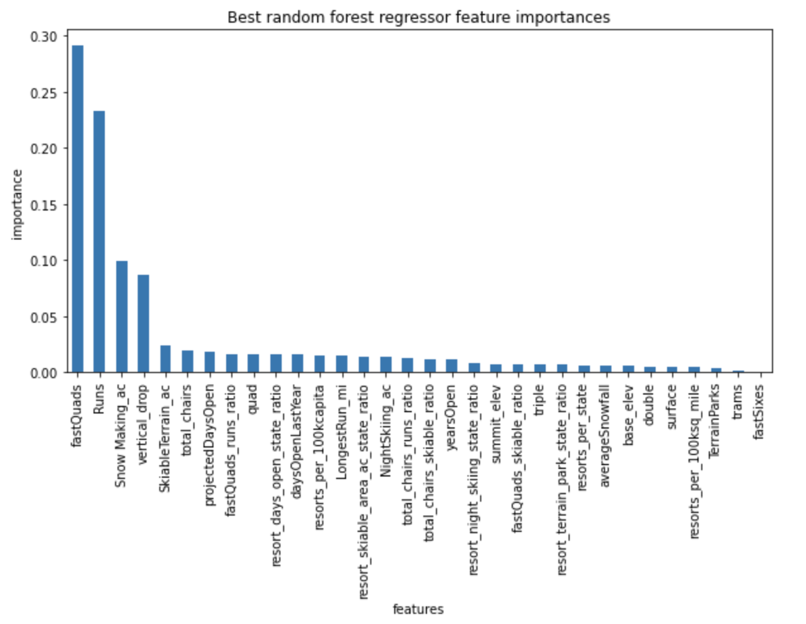
Key Features Driving Ticket Price
Fast Quads, Runs, Snow Making, and Vertical drop are by far the most important features
Based on this data an investment that optimizes as many of these features as possible is a strong direction to head
A High-Speed Quad that increases the vertical drop would in turn make increases in fast quads, runs, vertical drop, skiable terrain, and total chairs.
Keep in mind these features might have an inflated value because resorts that implement these new lifts, runs, and ski area are also trying to increase revenue.

Slide 5

Modeling Results and Analysis

Slide 6
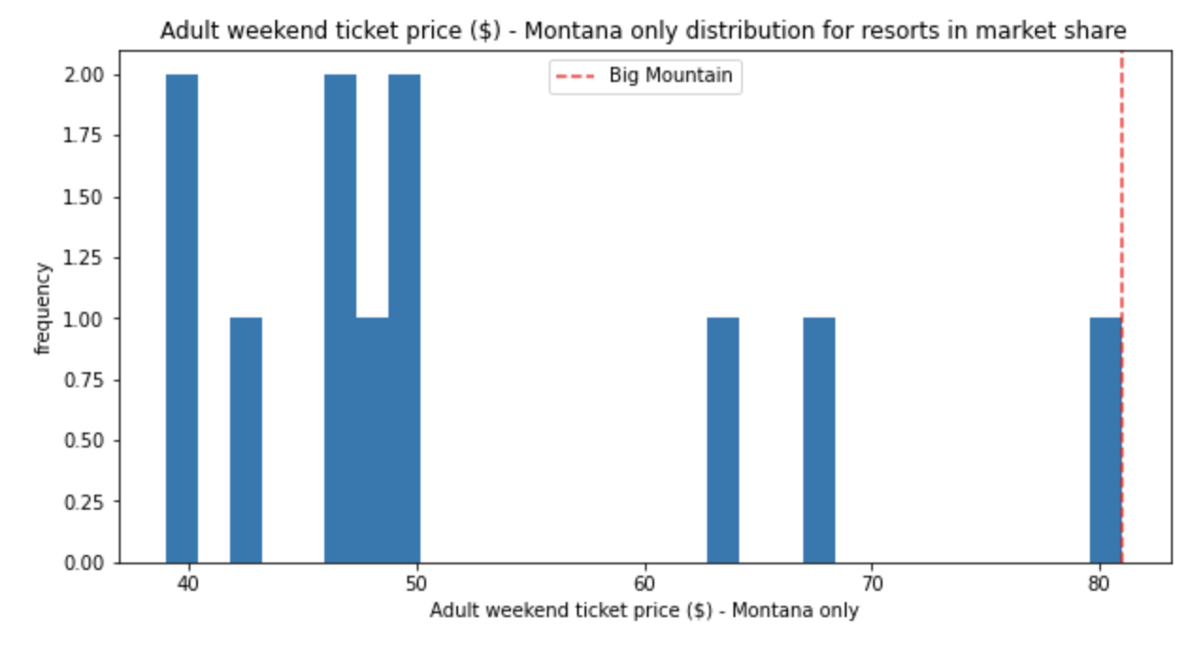
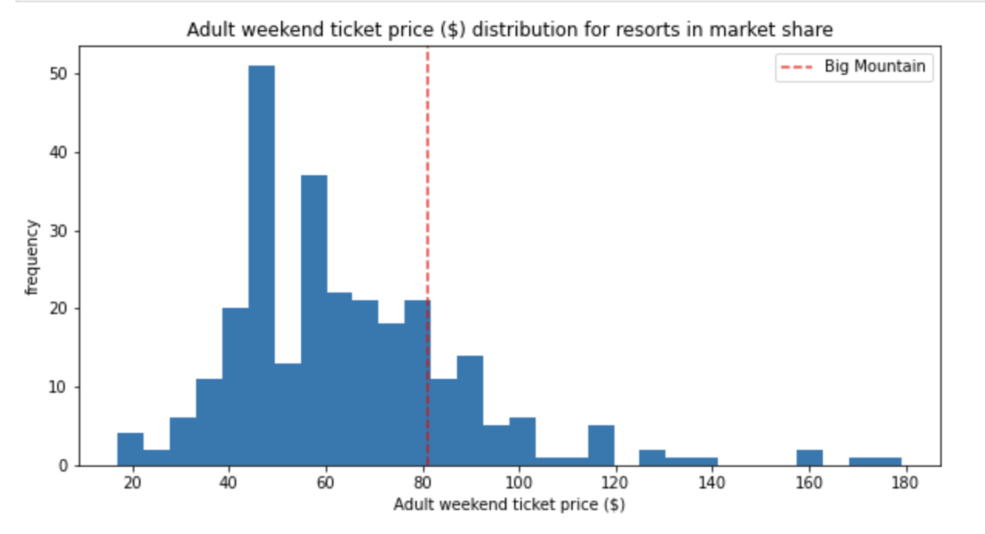
Ticket Price
As you can see our ticket price is on the high end, but as an elite resort it is justified and as we determined probably discounted
However Big Mountain is already the most expensive mountain in Montana by a significant amount
There are two ways of looking at this:
Big Mountain is the best resort in Montana and an increase in ticket prices will not effect customers from coming to ski at an elite mountain
Big mountain is the most expensive mountain already and increasing ticket prices will deter customers to other resorts
Hence the recommendation to raise the price incrementally in order to test the market’s reaction to price change

Slide 7
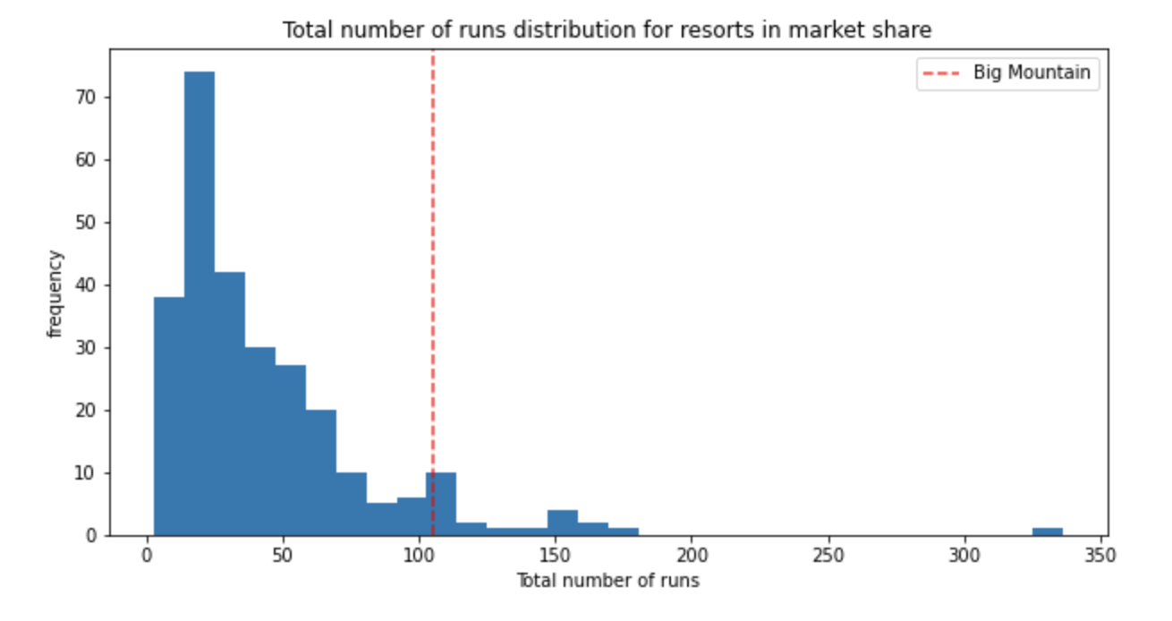
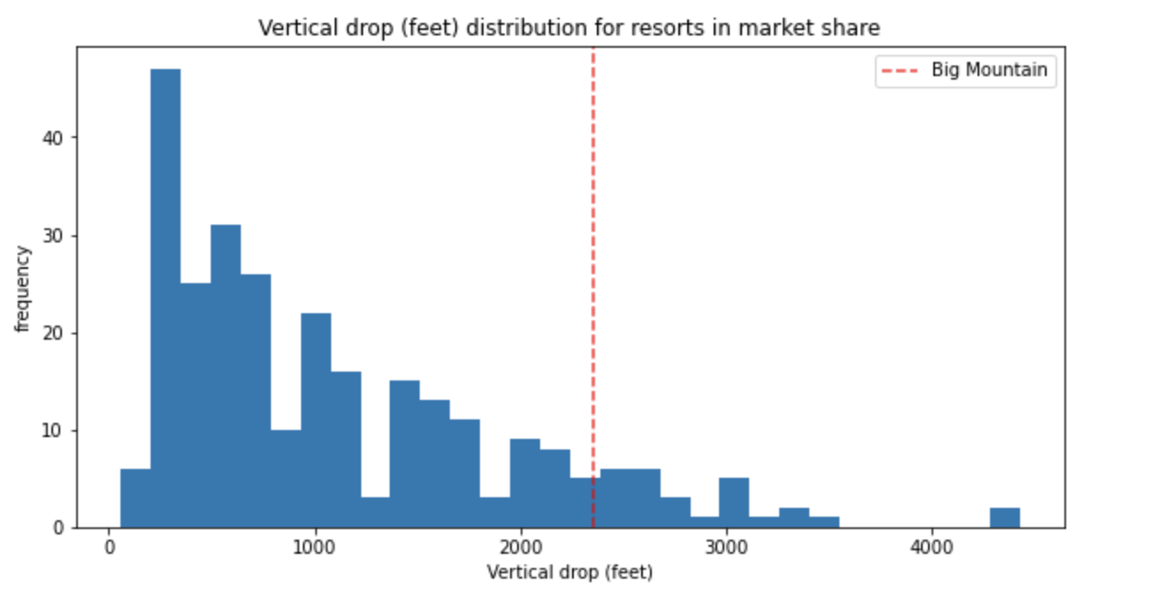
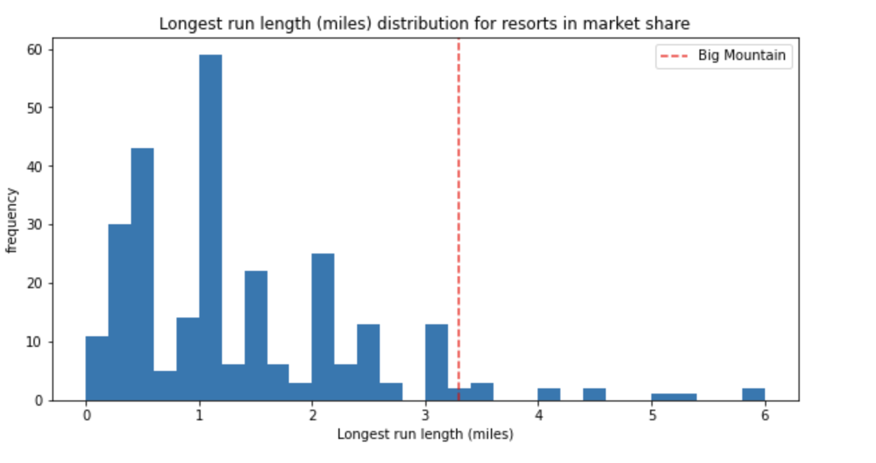
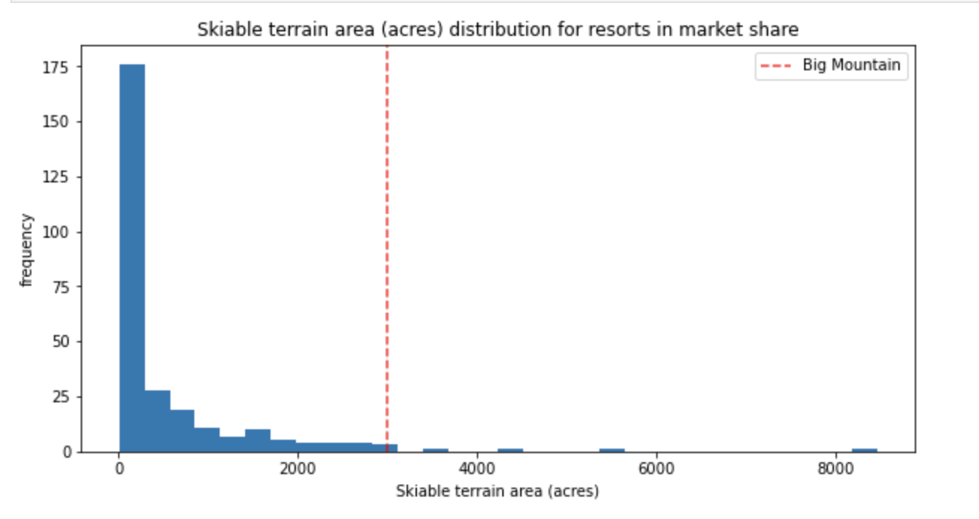
Mountain Features
We are clearly in at least the 75th percentile if not higher in all categories describing the mountain itself
This is a strong signal that price increase is justified

Slide 8
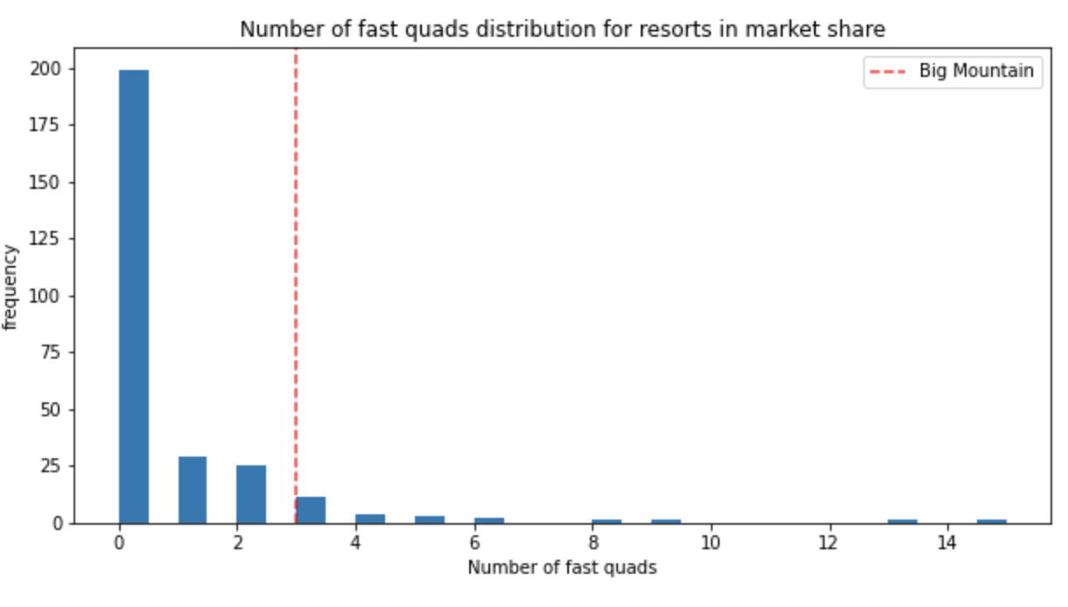
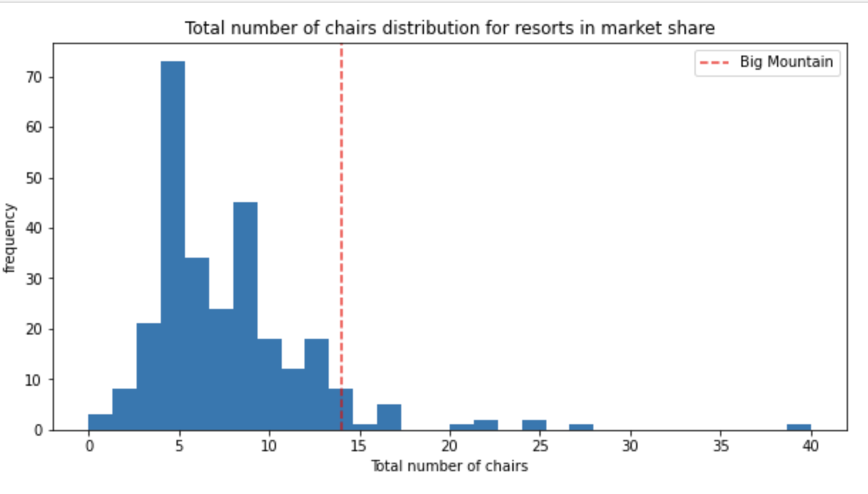
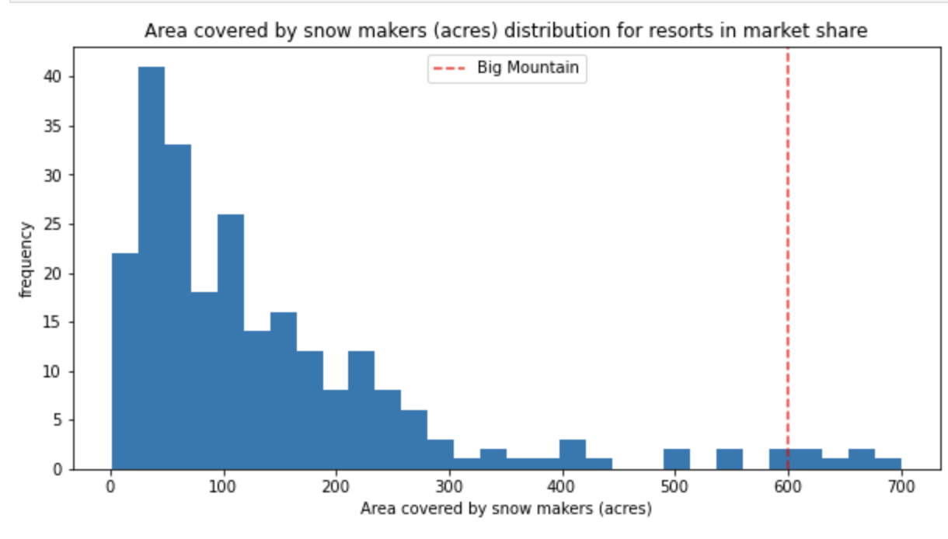
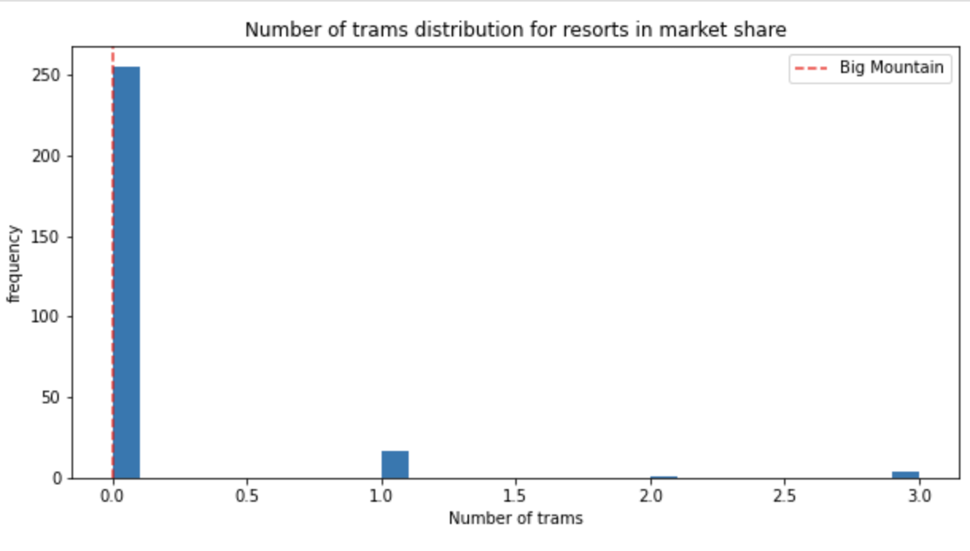
Mountain Equipment
We are vastly outperforming most mountains in terms of snow making, lifts, and quads
We like most resorts do not have trams which could be a area for improvement as well

Slide 9
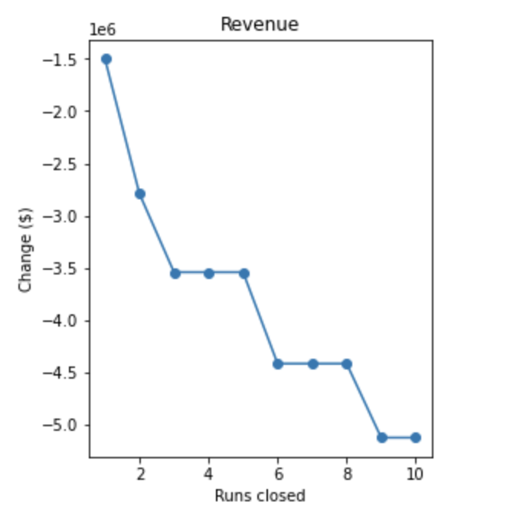
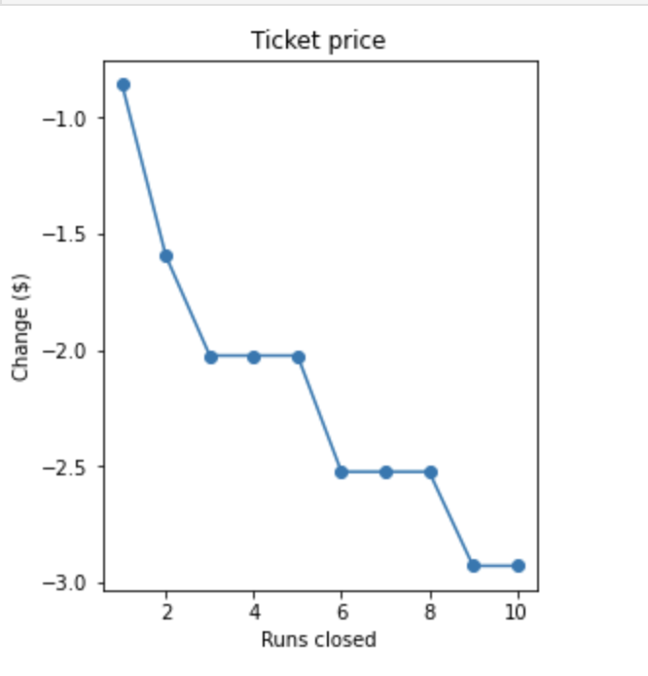
Scenarios
Scenario 1 – effect of closed trails: See figure
Scenario 2 – effect of increasing vertical drop by 150 ft by adding a chair lift: Increase in price point by $7.71
Scenario 3 – effect of adding 2 acres of snow making to scenario 2: Increase of total price point by $11.95
Scenario 4 – effect of increasing the longest run lead to no change at all

Slide 10
Conclusions
The data suggests that a price point with-in the range $87.81- $108.39 ($98.10)
The way the data is influenced by complex intangible factors masks a firm price recommendation but increasing it to 90 dollars and working our way up is an effective yet conservative strategy
This price increase is significant if we sell 350,000 tickets at a 10 dollar increase in price that will generate 3.5 million in revenue more then double the cost of the lift.
A 10-dollar price increase is a conservative estimate. A more realistic estimate is closer to 17-dollar price increase yielding close to 6 million in revenue.

